Slide 1
Searching for Hope from Minds Steeped in hopelessness:
What Predicts, What Prevents and What Heals a Suicidal Mind
Tayyab Rashid, Ph.D., C.Psych | University of Toronto Scarborough
Amanda Uliaszek | University of Toronto Scarborough
Mark Sinyor, MSc., MD, FRCPC | Sunnybrook Health Sciences Centre

Slide 2
Gratitude
This project, in part, was supported through the Mental Health Innovation Fund (MHIF) from the Ministry of Training of Colleges & Universities (TCU)
UTSC: Danielle Uy, Arey Maharaj, Irfan Hakim, Dr. Andrew Cooper & Dr. Suzanne Erb
Health & Wellness Staff & IITS
Notes:
Ary
Part of a larger project that resulted in 27 recommendations split between secondary and post-secondary administrators, mental health professionals, student service professionals, and government bodies

Slide 3
Overview
What is suicidal behaviour?
What are insights from existing literature and surveys in post-secondary settings?
Insights from our study: what are correlates and predictors of suicidal behaviour (symptoms & strengths)
Who improves and what facilitates improvement?
Treatment
  How many seek treatment
  Engagement
  Resources
Notes:
Tayyab

Slide 4
SELF-HARMING BEHAVIOURS
Suicidal Behaviour (SB)
Non-suicidal Self Injury (NSSI)
This presentation is about SB
Notes:
Tayyab

Slide 5
NONSUICIDAL SELF-INJURY (NSSI)
Deliberate self-harm, parasuicide behaviour, self-injurious & self-wounding
Suicidal Intent is absent
Prevalence: Clinical Samples: 21% adults; 40% adolescents
Onset: 12-16
Signs: repeated cutting, stabbing, burning, hitting, excessive rubbing to inflict self damage to body tissue for socially sanctioned reasons
The focus of this presentation is primarily on Suicidal behaviour, not NSSI
Notes:
Stat Can Summary
http://statcan.gc.ca/pub/82-624-x/2012001/article/11696-eng.htm
In 2009 there were 3,890 suicides in Canada, a rate of 11.5 per 100,000 people.
The suicide rate for males was three times higher than the rate for females (17.9 versus 5.3 per 100,000).
Although suicide deaths affect almost all age groups, those aged 40 to 59 had the highest rates.
Married people had a lower suicide rate than those who were single, divorced or widowed.
Toprak, S., Cetin, I., Guven, T., Can, G., & Demircan, C. (2011). Self-harm, suicidal ideation and suicide attempts among college students. Psychiatry Research, 187(1), 140-144.
Signs: repeated cutting, stabbing, burning, hitting, excessive rubbing to inflict self damage to body tissue for socially sanctioned reasons
Most often inflicted with a sharp object, resulting in cuts, bleeds
where?
dorsal (back) side of forearms
anterior thighs
characteristic marks

Slide 6
SUICIDAL BEHAVIOUR
Actions taken to deal with intolerable mental anguish & pain
  Despair about value of living & hope in life
Suicidal Complexity: Unique mix of interconnected factors
Prevalence
  Stat Can (2009): 11.5 per 100,000
    Highest rate: age 40-59
    Gender difference
    Protective Factors
Notes:
Tayyab
Canadian Association of Suicide Prevention
https://suicideprevention.ca/
1. Actions taken to deal with intolerable mental anguish and pain,
2. fear or despair that overwhelms an individual’s value for living and hope in life.
3. Unique mix of complex interconnected factors, individual, environmental, biological, psychological, social, cultural, historical, political and spiritual, including psychological trauma (both developmental and intergenerational).
Stat Can Summary
http://statcan.gc.ca/pub/82-624-x/2012001/article/11696-eng.htm
In 2009 there were 3,890 suicides in Canada, a rate of 11.5 per 100,000 people.
The suicide rate for males was three times higher than the rate for females (17.9 versus 5.3 per 100,000).
Although suicide deaths affect almost all age groups, those aged 40 to 59 had the highest rates.
Married people had a lower suicide rate than those who were single, divorced or widowed.

Slide 7
Course & Progression
Suicide has no clear course & prognosis
Suicidal ideation is relatively common
Topography of suicidal thoughts -- on a continuum: from passive longing for death to suicidal intent and plans
The mind scans its options: the topic of suicide comes up, the mind rejects it, scans it again, there is suicide, it is rejected again, and then finally the mind accepts suicide as a solution, then plans it, then fixes on it as the only answer (p. 15; Shnedman, 1996; The Suicide mind.
60% who transition from ideation to first attempt tend to be within first year year after the onset of suicidal ideation
Notes:
Sheindman, E. S. (1996). The Suicide Mind. New York: Oxford.

Slide 8
Complexity
Suicidality
Other Psychiatric Conditions
Chronic Medical Condition
Substance Abuse
Hopelessness
Family Dynamics
Mix of Risk Factors
Gender, Age
Continued Intent
Desire to ”feel”
Trauma/Abuse
Hopelessness
Acculturation
Notes:
Tayyab
Navaneelan, T. (2012). Suicide rates: An overview. Health at a Glance. (Statistics Canada Catalogue no. 82-624-X). Retrieved from www.statcan. gc.ca/pub/82-624-x/2012001/article/11696-eng.htm
CAMH Suicide Prevention and Assessment Handbook, 2015
https://www.camh.ca/en/hospital/health_information/a_z_mental_health_and_addiction_information/suicide/Documents/SuicidePreventionHandbook.pdf
Individual factors:
Gender & Age
Presence of ongoing MH issues (e.g., depression, ADHD)
Substance Abuse
Previous attempt and previous self-harm
Psychiatric history (especially in-patient treatment)
High ongoing suicidal intent
Chronic medical Condition
Wishing to feel emotions over of emotions (e.g., avolition, emptiness)
Hopelessness (inability or unwillingness to act)
Kiran, K. P. K., Sukesh, Kakunje, A., & Bhagavath, P. (2013). Epidemiology of psychiatric disorders in deliberate self harm victims. Journal of Evolution of Medical and Dental Sciences, 2(7), 738.

Slide 9
Risk Factors
A relative risk of 1 = there is no difference in risk between individuals with the risk factor and the general population.
A relative risk of < (less than) 1 means the event is less likely to occur in individuals with the risk factor than in the general population.
A relative risk of > 1 means the event is more likely to occur in individuals with the risk factor than in the general population.

Slide 10
RELATIVE RISK OF SUICIDE IN SPECIFIC DISORDERS
Eating Disorders 23.1
Previous Attempt 38.4
Bipolar Disorder 15
Major Depression 20.4
Mixed Drug Abuse 19.2
Adapted from American Psychiatric Association, 2003, pp. 30, 41
Notes:
Tayyab
A relative risk of 1 mans there is no difference in risk between individuals with the risk factor and the general population.
• A relative risk of < (less than) 1 means the event is less likely to occur in individuals with the risk factor than in the general population.
• A relative risk of > 1 means the event is more likely to occur in individuals with the risk factor than in the general population.
(Adapted from Practice Guideline for the Assessment and Treatment of Patients with Suicidal Behaviors [American Psychiatric Association, 2003, pp. 30, 41])
Becker, S. P., Holdaway, A. S., & Luebbe, A. M. (2018). Suicidal Behaviors in College Students: Frequency, Sex Differences, and Mental Health Correlates Including Sluggish Cognitive Tempo. Journal of Adolescent Health, 63(2), 181–188. https://doi.org/10.1016/j.jadohealth.2018.02.013

Slide 11
Age-specific risk of self-harm in specific Psychiatric Conditions
(sINGHAL ET AL., 2014)
Age range: 10-24
  Depression
  Bipolar
  Alcohol Abuse
  Anxiety
  Eating Disorders
  Schizophrenia
  Substance Abuse
Notes:
Singhal, A., Ross, J., Seminog, O., Hawton, K., & Goldacre, M. J. (2014). Risk of self-harm and suicide in people with specific psychiatric and physical disorders: comparisons between disorders using English national record linkage. Journal of the Royal Society of Medicine, 107(5), 194–204. https://doi.org/10.1177/0141076814522033
Very high RR Depression39,52414.1 (14.0–14.3)18,11123.1 (22.6–23.7)21,41311.7 (11.5–11.9) Bipolar disorder573311.6 (11.3–11.9)211118.0 (17.2–18.8)36229.7 (9.3–10.0) Alcohol abuse39,8788.0 (7.9–8.1)15,06112.8 (12.5–13.1)24,8176.7 (6.6–6.8) Anxiety and neurotic disorders19,3137.8 (7.7–8.0)891313.6 (13.3–14.0)10,4006.0 (5.9–6.1) Eating disorders20737.5 (7.2–7.9)87913.3 (12.4–14.3)11945.7 (5.4–6.1) Schizophrenia13,0177.2 (7.1–7.4)435011.4 (11.0–11.8)86676.2 (6.0–6.3) Substance abuse
Conditionsn
RR* with 95% CI Self-harm cases/suicidesPsychiatric
Bipolar disorder 35917.9 (16.0–20.0)16.0
Depression175312.9 (12.2–13.7)22.5
Schizophrenia90510.6 (9.8–11.4)14.4
Anxiety and neurotic disorders7648.8 (8.2–9.6)25.3
Eating disorders188.4 (5.0–13.4)115.2
Alcohol abuse10274.7 (4.4–5.0)38.8
Substance abuse5624.7 (4.3–5.2)31.1

Slide 12
Canadian Context:
Suicidal thoughts, plans and attempts
 | STAT CAN (N= 4, 032) (15-24 years) | NCHA 2016 (N=43,780) 74% (18-24)
Suicidal Thoughts | 14.1% | 13%
Suicide Plan | 4.95 | 2.2%
Suicide Attempt | 3.5% | 2.1%
NSSI | N/A | 8.7%
Notes:
Tayyab
Stat Can Data: The data are from the 2012 Canadian Community Health Survey–Mental Health (CCHS–MH), which targeted the household population in the 10 provinces. The analysis pertains to 4,031 respondents aged 15 to 24, weighted to represent more than 4.4 million individuals.
file:///Users/tayyabrashid/Pictures/For%20Presentations/Suicidal%20Ideation.html
NCHA-ACHA DATA: American College Health Association. American College Health Association-National College Health Assessment II: Canadian Reference Group Executive Summary Spring 2016. Hanover, MD: American College Health Association; 2016.
http://www.acha-ncha.org/docs/NCHA-II%20SPRING%202016%20CANADIAN%20REFERENCE%20GROUP%20EXECUTIVE%20SUMMARY.pdf

Slide 13
STANDARDIZED Assessment: A FEW ILLUSTRATIONS
 | Tool/Measure | Description
1 | Suicide Status Form-SSF III | Psychological Pain, Stress, Agitation, Hopelessness, Self-hate, Reasons for Living, Reasons for Dying
2 | The Columbia-Suicide Severity Rating Scale (C-SSRS) | Available in 114 country-specific languages
3 | SAF-T: Suicide Assessment Five-Step Evaluation and Triage | Follows American Psychiatric Association Practice Guidelines
4 | Cultural Assessment of Risk for Suicide (CARS) | First measure which identifies cultural suicide risk factors not previously attended to in suicide assessment.
5 | Beck Scale for Suicide Ideation | BSI is a 21-item self-report questionnaire that may be used to identify the presence and severity of suicidal ideation.
Notes:
Assessment
Chu J1, Floyd R, Diep H, Pardo S, Goldblum P, Bongar B. A tool for the culturally competent assessment of suicide: the Cultural Assessment of Risk for Suicide (CARS) measure.
Psychol Assess. 2013 Jun;25(2):424-34. doi: 10.1037/a0031264. Epub 2013 Jan 28.

Slide 14
Suicidal behaviour: INSIGHTs
Notes:
Tayyab or Amanda

Slide 15
demographics: Age & GENDER
REB APPROVED
N=2757 (2012-1017)
Age: 20.9 years (SD 3.32)
  89% (18-23)
Gender
  60% females
Full Time: 93%
Notes:
Tayyab

Slide 16
ETHNICITY %
N=2757
Notes:
Tayyab or Amanda

Slide 17
Living Situation
Notes:
Tayyab or Amanda

Slide 18
methodology
Intake: Online & In-person
Presenting Concerns
  Client Reported
  Clinician Interpreted
  Coding: Grounded Theory (Strauss & Corbin, 1998 )
    Coded Presenting Concerns by 4 coders
    Weekly meetings to discuss codes, construct clarified
    Redundant codes incorporated into broader categories
Notes:
Tayyab or Amanda
Amanda, if you are covering it, I can explain this to you prior to the presentation
The research team included one licensed clinical psychologist, one graduate student in counselling and two senior (4th year) undergraduate students. Team members individually coded clinical descriptions and met weekly to discuss the development of codes. At weekly meetings, further discussion allowed new codes to emerge from the data, definitions to be revised, and constructs to be clarified. The team incorporated redundant codes into broader categories and divided broader categories into more clinically distinct categories.
Strauss, A. & Corbin, J. (1998). Basics of qualitative research: Techniques and procedures for developing grounded theory. 2nd ed. London: Sage Publications.
Once the team had generated a solid code list and streamlined the process, we conducted the second phase of analysis. In this phase, three coders independently coded each case. Wherever two coders differed, a fourth coder (first author: TR) arbitrated and resolved discrepancies.

Slide 19
OUTCOME MEASURE
Intake Process included Outcome Questionnaire (OQ-45)
Students completed on a tablet, before in-person part of the intake.
The measure assesses suicidal ideation through an item,
“I have thoughts of ending my life”.
  Students respond to the question on a 5-point Likert Scale.
Notes:
Tayyab or Amanda

Slide 20
In-person assessment
Have you ever seriously thought about killing yourself?
    No Yes: (if yes, follow-up)
Are you currently thinking of killing yourself?
Have you ever engaged in self-harming behaviour?
Are you currently engaged in self-harming behaviour?
Notes:
Tayyab or Amanda

Slide 21
Prevalence Suicidality – 2 Methods
Intake suicidal ideation question, clinical interview at intake:
“Are you currently thinking of killing yourself?”
  Yes/No per clinician judgment during initial session
OQ-45 suicide item, per self-report prior to intake :
“Have you had thoughts of ending your life?”
  1(never) – 5 (almost always)*
    4+ treated as endorsement
9.8%
8.5%
Notes:
Tayyab or Amanda

Slide 22
CAPTURING suicidal ideation
Clinical Interview vs. Objective measure: overlap %
Sometimes
Ideators captured
at intake
Frequently
Almost Always
Almost Always, 66.7%
Frequently, 51.9%
Sometimes, 21.4%
Notes:
Tayyab or Amanda
About 10% of client report suicidal ideation at the intake (interview). Similarly, using the OQ-45, 8.5% of clients were found to be experiencing suicidal ideation frequently to almost always in the past week.
The Venn diagram on the right illustrates the overlap percentage between the two measures. Although rates are similar, both measures are not capturing the same clients. 67% of clients responding with almost always on the OQ-45 are also identified by clinicians at intake. This percentage drops to 52% for clients responding with frequently.
Anchor – captured – not captured
Almost Always 66.70% 33.30%
Frequently 51.90% 48.10%
Sometimes 21.40% 78.60%
Rarely 3.00% 97.00%
Never 0.70% 99.30%

Slide 23
Suicidality & Demographics
%
Notes:
AMANDA
Percentages – no significant differences
Identifying as a visible minority, on the other hand, was significantly associated with intake versus emergent
ideation (χ2 [1,505] = 4.83, p < .05). Visible minorities were more likely to be intake ideators
whereas non-visible minorities were more likely to be emergent ideators.

Slide 24
Suicidality as presenting concern (PC) & CGPA
Notes:
Amanda

Slide 25
Suicidality & Number of Presenting Concerns
Notes:
Amanda
Significant difference

Slide 26
Suicidality & SPECIFIC Presenting Concerns
Notes:
Amanda
Significant difference

Slide 27
Suicidality & Symptom Severity AT THE TIME OF INTAKE
Notes:
Amanda
All significant
Symptom Distress (SD)
Range: 0-100
Clinical Cut-off: 36 or more indicates symptoms of clinical significance
SD scale is composed of items that often reflect symptoms associated with anxiety, affective or adjustment disorders. Symptoms scores correlate highly with various measures of depression (e.g., BDI) and Anxiety (e.g., the state-trait anxiety).
Interpersonal Relations (IR)
Range: 0-44
Clinical Cut-off: 15 or more
IR assesses concerns such as loneliness, conflict with others, family and relationship issues. A high score suggests difficulties in these areas
Wellbeing: Higher the better, no normative data available

Slide 28
Suicidality & Strengths
Within Normal Range Scores
Appreciation of Beauty
Authenticity
Curiosity
Fairness
Mercy
Gratitude
Generosity
Love of learning
Humility
Critical thinking
Spirituality
Significantly Lower
Bravery
Capacity to love
Creativity
Emotional Intelligence
Hope
Humor & Playfulness
Leadership
Perseverance
Perspective
Prudence
Self control
Teamwork & Citizenship
Zest
Notes:
Amanda
Lower

Slide 29
SI: Predictors
1. Those who present with suicidal ideation (OQ-45) show significantly more
  Worthlessness
  Feeling loved
  Lower overall wellbeing
  Higher overall symptomatic distress
2. OQ SI is associated with a greater chance of a presenting concerns related to suicidality, relationship (general), motivation/interest, emotion dysregulation, depressive symptoms, anxiety/panic, general anxiety

Slide 30
SI: Predictors
Does the knowledge of Strengths tell anything about overall distress?
42% of variance in total OQ
unique predictors of SI included: forgiveness, gratitude, hope, kindness, capacity to love, persistence, prudence, spirituality, self regulation, citizenship, zest
How Much?
Strengths explained 16% of variance in OQ suicidal ideation
Strengths predict incrementally over an above all presenting concerns when predicting OQ Risk

Slide 31
Final MODE of INTAKE IDEATORS
History of Suicide Attempts: Odds Ratio = 2.35***
OQ Symptom Distress = OR 1.08***
Hope .92 .88 .98**
Persistence 1.08**
**p < .001; ***p < .001

Slide 32
Who IMPROVES & WHO DETERIORATES
Zest
Hope
Love
Curiosity
Gratitude
Notes:
Amanda, we have this finding from Danielle’s thesis. I can insert it, if you prefer to present it. If not, we can delete it.

Slide 33
TREATMENT AND policy implications for post secondary institutes
Notes:
Tayyab or Amanda

Slide 34
Engagement:
How many youth seek treatment ?
  Szumails & Kutcher, 2009
  Reviewed quality of online information about suicide
  Stat Can (N= 4, 013), age 15-24
  Discuss with Family doctor/GP: 6%
  Seek clinical services: 5%
  Seek psychiatric consultation: 3%
  Use online diagnostic information: 8%
  Share it on social media: 2%
  Immigrants are less likely to seek services
Notes:
Mark: this is a slides from previous presentation, see if you want to use it
Szumails & Kutcher, 2009
Reviewed quality of online information about suicide
More than half the statements about suicide on most popular Canadian websites were not supported by evidence
Seek high quality, evidence-based information, that is readily accessible to users,

Slide 35
EVIDENCE-BASED PROGRAMS FOR SELF-HARMING BEHAVIOUR
Suicide Gatekeeper Training: ASSIST, MH First AID, QPR, KOGNITO, ASK, LISTEN, REFER
Cognitive Behaviour Therapy
    Manual-Assisted CBT: Working Through advantages & disadvantages
Problem Solving Therapy
  Problem Definition, Brainstorming, Alternative Solution
Multi systemic Therapy
  Behavourial Parenting Training
Dialectical Behaviour Therapy
Emergency ”Green Cards.”
Mentalization-Based Treatment (MBT)
  Understanding actions in terms of thoughts & feelings
Physical Activity
Notes:
These Evidence based Treatments are described in
Jane Burns, Michael Dudley, Philip Hazell, George Patton, Clinical management of deliberate self-harm in young people: the need for evidence-based approaches to reduce repetition, Australian and New Zealand Journal of Psychiatry 2005; 39:121–128
QPR: Question, Persuade, Refer
Glenn CR, Franklin JC, Nock MK (2015). Evidence-based psychosocial treatments for self-injurious thoughts and behaviors in youth. Journal of Clinical Child & Adolescent Psychology 44, 1–29.

Slide 36
Dr. Mark Sinyor, MSc., MD, FRCPC
Sunnybrook Health Sciences Centre

Slide 37
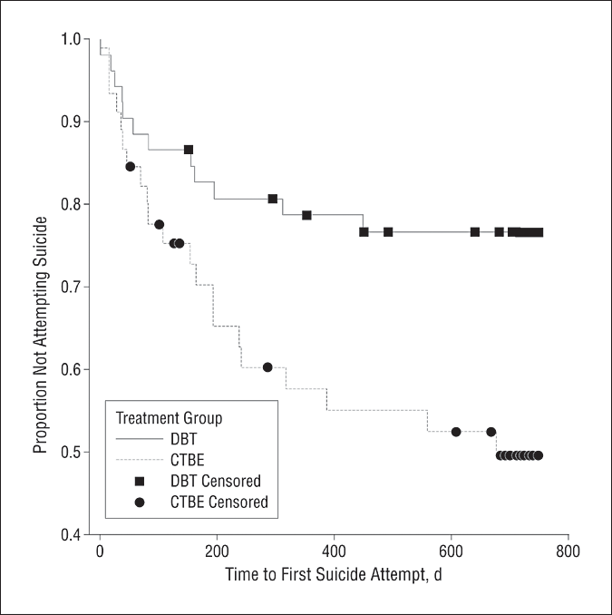

Survival analysis for time to first suicide attempt
Linehan, M. M. et al. Arch Gen Psychiatry 2006;63:757-766.
Copyright restrictions may apply.
Notes:
CTBE = community treatment by experts (52 in DBT group, 49 in CTBE)

Slide 38
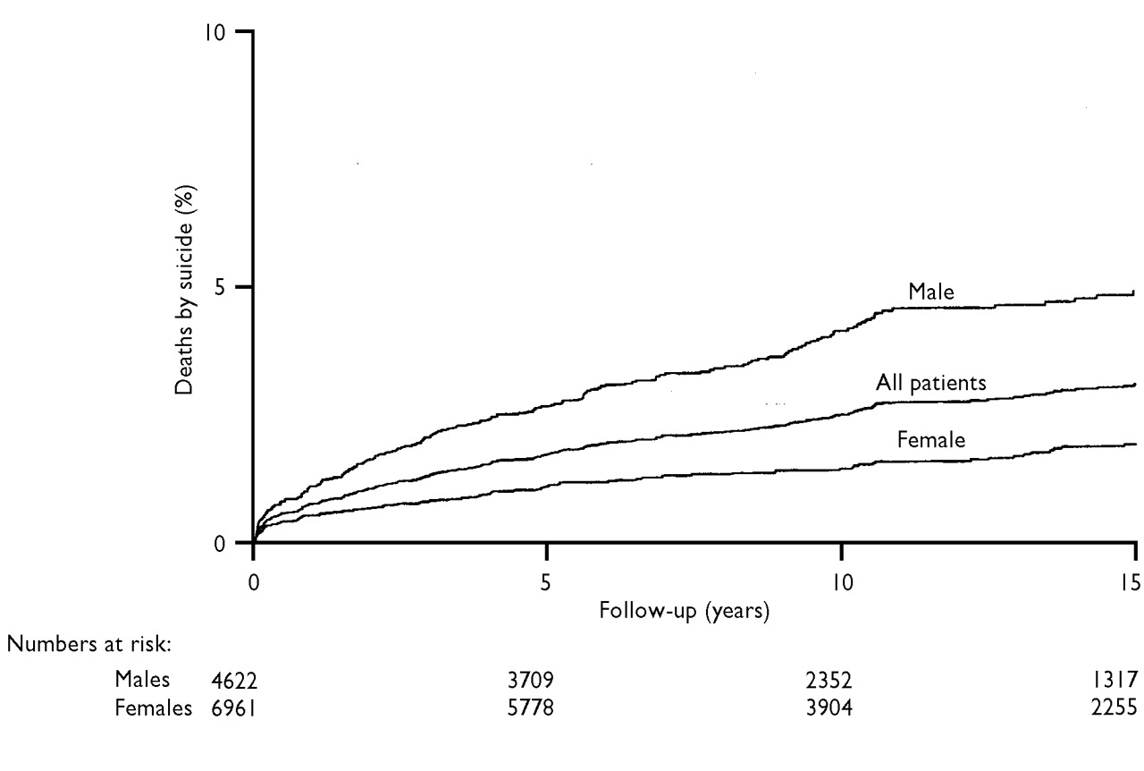

Cumulative percentages of suicides over the 15-year follow-up period.
HAWTON K et al. BJP 2003;182:537-542
©2003 by The Royal College of Psychiatrists
Notes:
Cumulative percentages of suicides over the 15-year follow-up period. – in people who presented with deliberate self harm

Slide 39
Risk Factors vs. Warning Signs
some examples:
Risk Factors | Warning Signs
Age (older) | Hopelessness
Sex (male) | Seeking access to lethal means
Genetic factors/family history | Threatening to hurt/kill self
Childhood trauma | Escalating substance use
Psychiatric diagnoses | Social withdrawal/isolation
Past suicidal behaviour | Agitation/sleep disruption

Slide 40
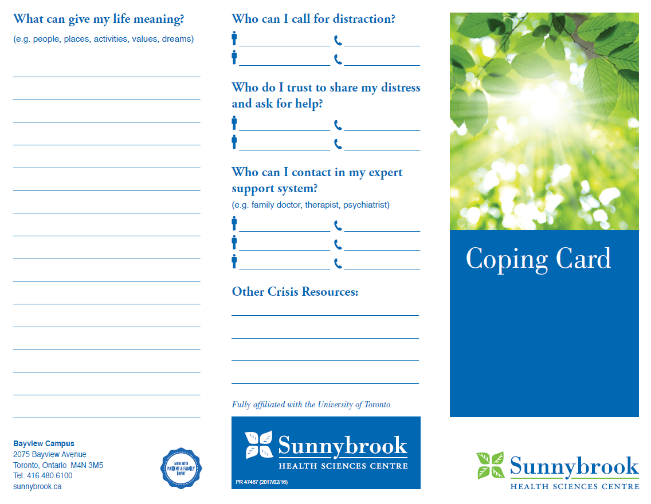
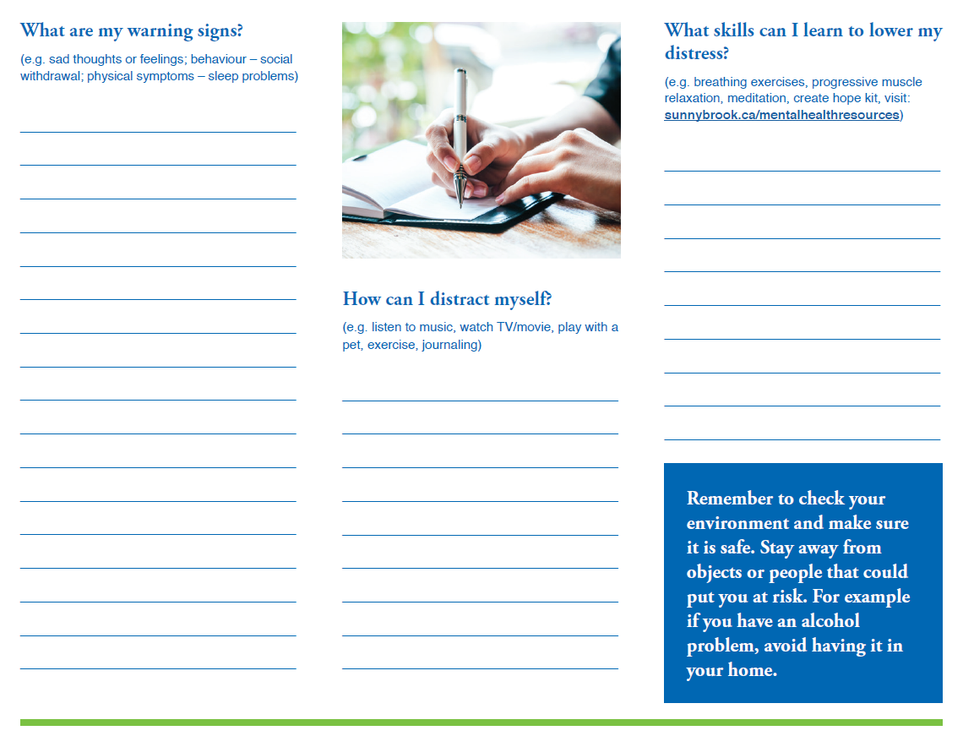

Slide 41
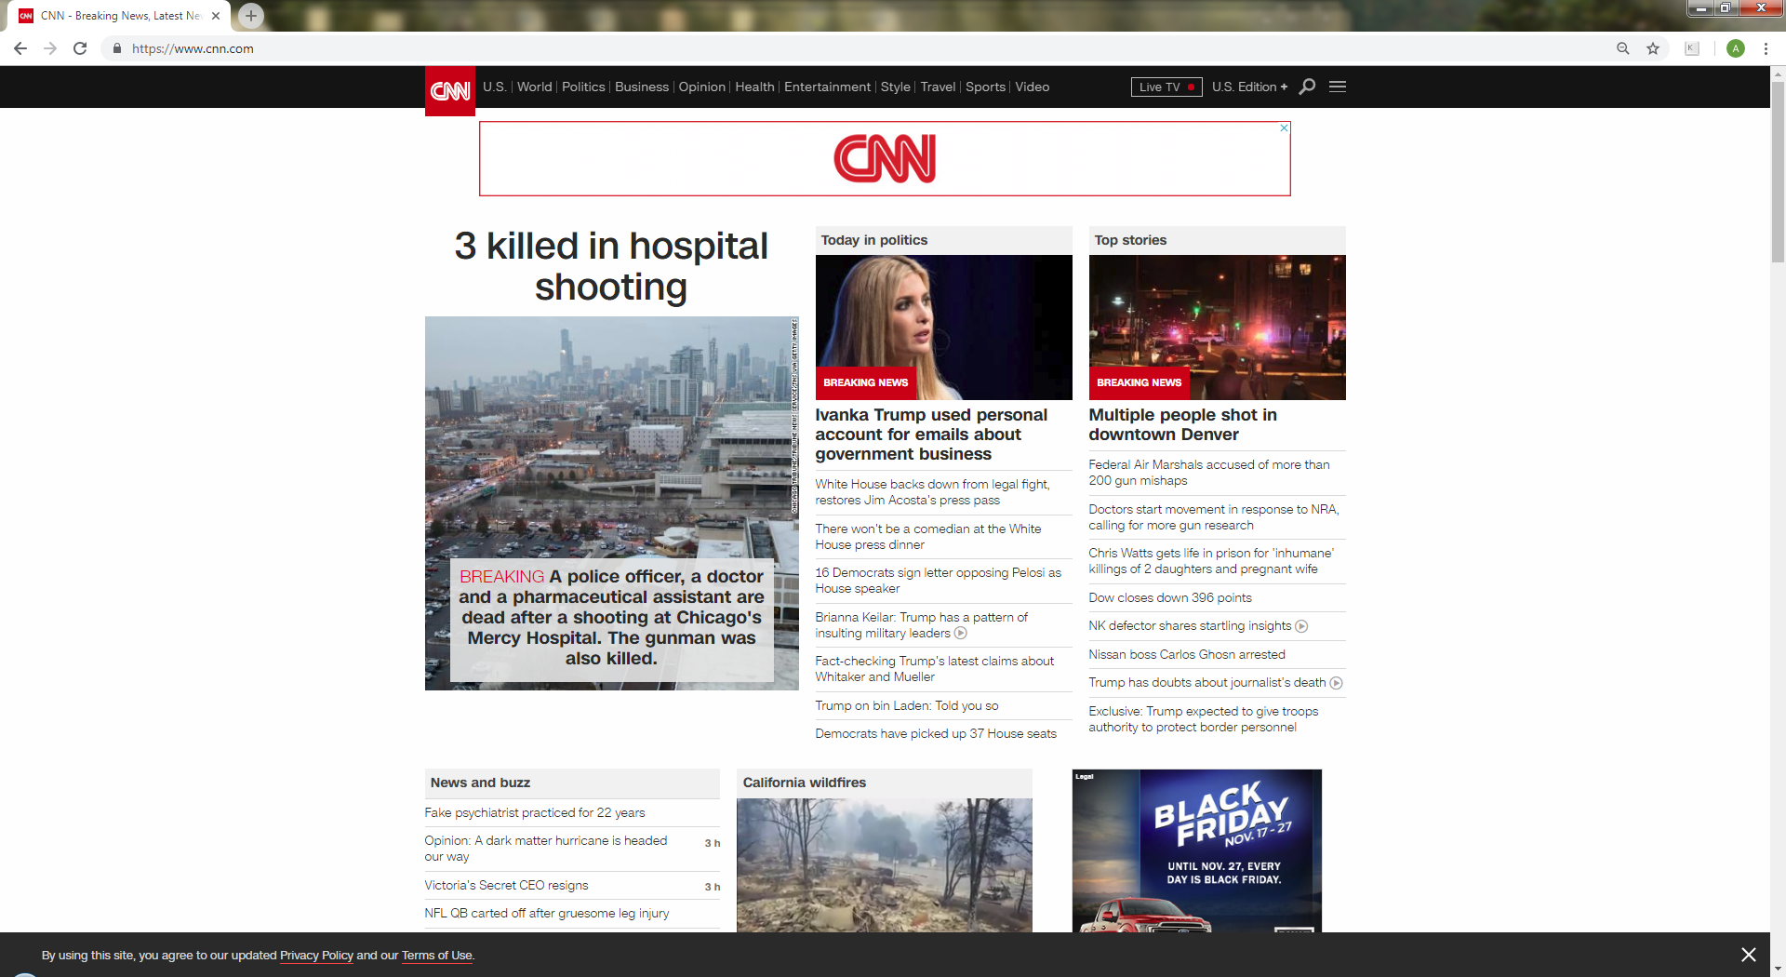

Slide 42
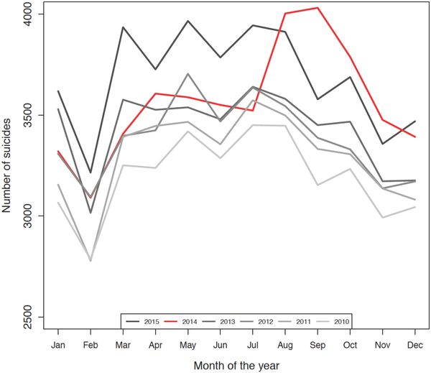

Monthly number of suicides in the United States from January 2010 to December 2015.
Aug-Dec 2014
expected:
16,849 deaths
observed:
18,690 deaths
excess:
1,841 deaths (9.85%↑)
Fink DS, Santaella-Tenorio J, Keyes KM (2018) Increase in suicides the months after the death of Robin Williams in the US. PLOS ONE 13(2): e0191405. https://doi.org/10.1371/journal.pone.0191405
http://journals.plos.org/plosone/article?id=10.1371/journal.pone.0191405

Slide 43
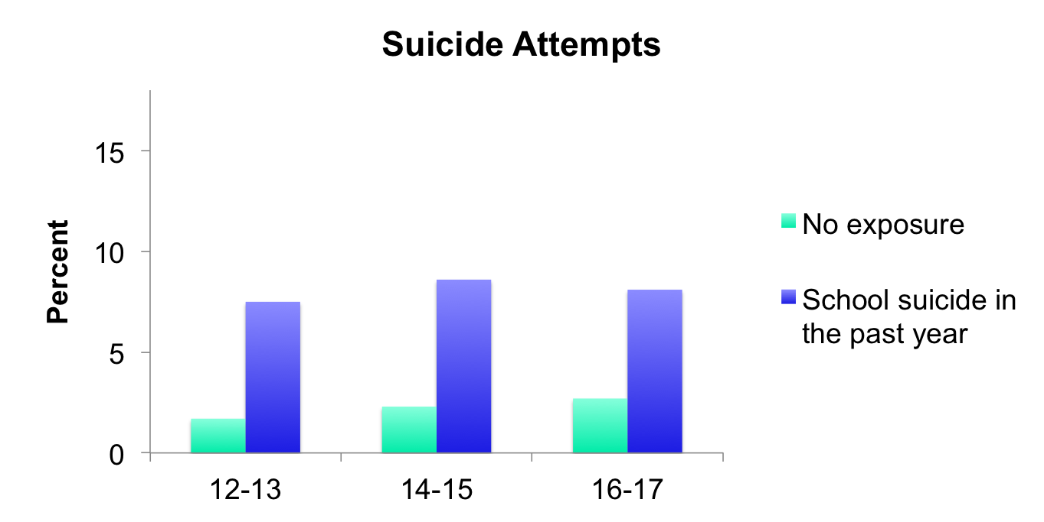
Exposure to School Suicide
6 x more likely
3.5 x more likely
3.3 x more likely
Swanson & Colman. CMAJ 2013; 185:870-7.

Slide 44

Papageno Effect
Notes:
Mazart’s the magic flute

Slide 45
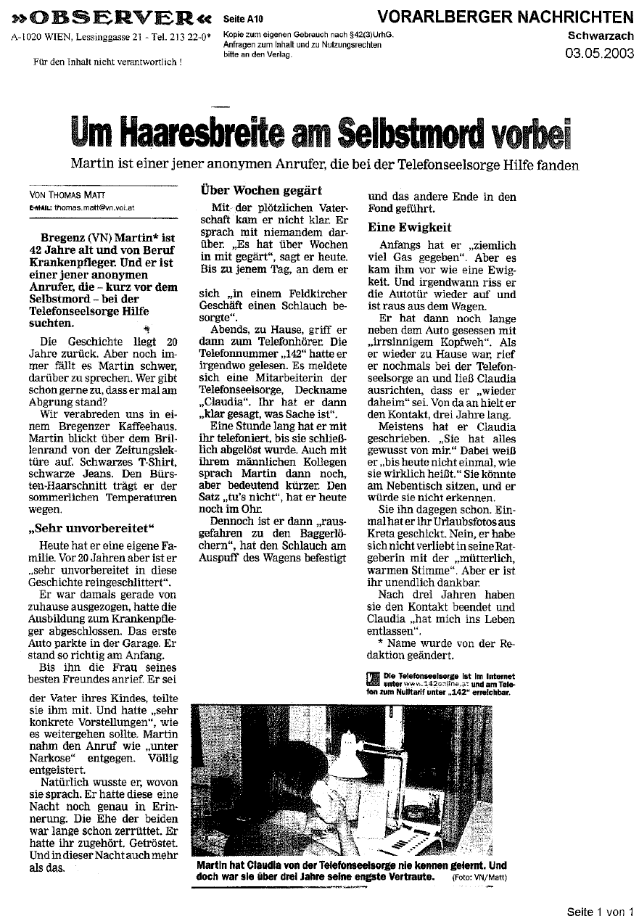
„Mastery of crisis class“(9% of articles)
Empathic description of how to cope with suicidal ideation / attempt.
Personal experience.
Similarities to narratives in self-help literature.
Association with small-sized decrease in suicide rates
Notes:
In einer anderen Berichtsklasse, die vorwiegend Artikel mit epidemiologischen Daten umfasste, waren protektiv und schädlich gelistete Charakteristika eng verflochten. Statistik wurde offenbar häufig in einem sensationsträchtigen Kontext präsentiert.
Um Hypothesen bezüglich möglicher Wirkungsweisen aufzustellen testeten wir Korrelationen zwischen den Berichtsmerkmalen sowie Berichtsklassen und Veränderungen der Suizidrate nach Erscheinen der Artikel.

Slide 46
Evidence based interventions
De Silva, S., Parker, A., Purcell, R., Callahan, P., Liu, P., & Hetrick, S. (2013). Mapping the evidence of prevention and intervention studies for suicidal and self-harming behaviors in young people. Crisis: The Journal of Crisis Intervention and Suicide Prevention, 34(4), 223-232.
Fischer, G., Brunner, R., Parzer, P., Resch, F., & Kaess, M. (2013). Short-term psychotherapeutic treatment in adolescents engaging in non-suicidal self-injury: A randomized controlled trial. Trials, 14(1), 294-294.
Fisher, G. (2016). Managing young people with self-harming or suicidal behaviour. Nursing Children and Young People, 28(1), 25.
Rutt, C. C., Buser, T. J., & Buser, J. K. (2016). Evaluating a training intervention for assessing nonsuicidal Self‐Injury: The HIRE model. Counselor Education and Supervision, 55(2), 123-136.
Sophie, I. L., Helleman, M., Daukantaite, D., Westrin, A., & Westling, S. (2017). A standardized crisis management model for self-harming and suicidal individuals with three or more diagnostic criteria of borderline personality disorder: The brief admission skane randomized controlled trial protocol (BASRCT). BMC Psychiatry, 17
Wheatley, M., & Hollin, C. (2005). The development of behavioural coping skills in a repetitive and deliberately self-harming young woman. Behavioural and Cognitive Psychotherapy, 33(2), 237-242.
Notes:
Tayyab

Slide 47
Resources: bOOKS
Assessment and care of adults at risk for suicidal ideation and behaviour
Registered Nurses' Association of Ontario, 2009
Treating depressed and suicidal adolescents : a clinician's guide
David A. Brent, Kimberly D. Poling, and Tina R. Goldstein. New York : Guilford Press, 2011
Preventing patient suicide : clinical assessment and management
Robert I. Simon. Washington, DC : American Psychiatric Pub., 2011. 1st ed.

Slide 48
Resources: websites & HELPLINES
1-866 627 3342; MON - FRI (6-9 PM
Canadian Association of Suicide Prevention
https://suicideprevention.ca/
613)702-4446
Suicide Prevention Resource Centre
www.sprc.org
Ontario Mental Health Helpline
www.mentalhealthhelpline.ca/
1-866-531-2600
See resources on Self-harm & Self-cutting page
Self-Injury Outreach and Support
http://www.sioutreach.org
Notes:
Canadian Association of Suicide Prevention
https://suicideprevention.ca/
Suicide Prevention Resource Centre
www.sprc.org

Slide 49
ADDITIONAL SLIDES IF NEEDED

Slide 50
confidentiality
    Every encounter/interaction with the self-harming young person is an opportunity to intervene and has the potential to save life
    Explain Confidentiality:
      Ensure person understand the limits
      Understand Family/Cultural barriers
      Collaborate how it can work to keep the individual safe but also helps them to “unload”
      “how can we make this a safe and comfortable place to discuss most uncomfortable things.”

Slide 51
explore
Questions
    Are You thinking about Suicide?
    Are you thinking about Killing yourself?
    Are you thinking about ending your life?
    Do you feel hopeless? So hopeless that you will kill yourself?
    Do you ever wish you were dead? When?
                (McKeon, 2008)
Evidence
Static: Risk Factors: Strongest one is....?
Dynamic: Warning Signs: Preparations (e.g., note, future mindedness, acquiesces, recent trauma, online groups affiliation)
Contagion Management: impact on others
Ambivalence vs. Assuredness
Notes:
Tayyab
Questions adapted from:
McKeon, R. (2008). Suicidal Behaviour. Hogrefe: Cambridge: MA

Slide 52
REASONS FOR suicidal behavior
  1. Cognitive Constriction
    Addictive quality
      Prior to engaging: a period of pre-occupation that is difficult to resist
  2. Emotional Anguish
  to stop feeling bad, “to feel anything at all, even pain.”
  3. Interpersonal Entanglement
    To get reaction or attention from others, even if it is negative
  4. Control
  locus of control
Notes:
Tayyab
Canadian Association of Suicide Prevention
https://suicideprevention.ca/
Jacobson CM, Gould M. The epidemiology and phenomenology of non-suicidal self-injurious behavior among adolescents: a critical review of the literature. Arch Suicide Res. 2007;11(2):129–47.
Klonsky ED. Non-suicidal self-injury in United States adults: prevalence, sociodemographics, topography and functions. Psychol Med. 2011;41(9):1981–6.
Lloyd-Richardson EE et al. Characteristics and functions of non-suicidal self-injury in a community sample of adolescents. PsycholMed. 2007;37(8):1183–92
NSSI often co-exists with other psychopathology including mood disorders, personality disorders, and eating disorders and a is a strong predictor for future
suicide attempts.

Slide 53
SuicidAL bEHAVIOUR IN post-secondary Students
BeckeR, HOLDAWAY & luebbe, 2018
6146 individuals aged 18–33 years, 59% Females, 82% Caucasian, 8% Asian, 6% African Americans,
  Recruited 2002-03 & followed up 2007-10.
  91 cases (no history) of self-reported suicide attempts during the follow-up (5-year incidence of 1.5%)
  4% reported previous attempts
  2.2% will likely try again someday
  7.5% thought of suicide in the last year
    Of these 41.4% never told anyone
  24% classified with suicide risk based on empirically established idea
Notes:
Tayyab
Lack of well done prospective studies
This is one rare illustration but data is from US
Becker, S. P., Holdaway, A. S., & Luebbe, A. M. (2018). Suicidal Behaviors in College Students: Frequency, Sex Differences, and Mental Health Correlates Including Sluggish Cognitive Tempo. Journal of Adolescent Health, 63(2), 181–188. https://doi.org/10.1016/j.jadohealth.2018.02.013
De Luca, S.M., Franklin, C., Yueqi, Y., Johnson, S., Brownson, C., 2016. The relationship between suicide ideation, behavioral health, and college academic performance.
Community Ment. Health J. 52, 534–540.
Goldman-Mellor, S.J., Caspi, A., Harrington, H., Hogan, S., Nada-Raja, S., Poulton, R., et al., 2014. Suicide attempt in young people: a signal for long-term health care and
social needs. JAMA Psychiatry 71, 119–127.
Kosidou, K., Dalman, C., Fredlund, P., Lee, B.K., Galanti, R., Isacsson, G., Magnusson, C., 2014. School performance and the risk of suicide attempts in young adults: a longitudinal
population-based study. Psychol. Med. 44, 1235–1243.

