Slide 1
Self-Stigma
Dr. Mike Condra condram@queensu.ca Queen’s University

Slide 2

Agenda
Free Association Activity
What is Stigma and how can we recognize it?
Two types of Stigma
The Impact of Self-Stigma
How a Peer Mentor Can Help to lessen the impact of Self-Stigma

Slide 3

Free Association Activity (Part 1)
Write down the first things that come to mind when you think of mental illness or a person with mental illness.
Remember: There are no right or wrong answers. You don’t have to personally believe in or agree with the ideas that you write down. Write down whatever comes to mind.

Slide 4
Free Association Activity (Part 2)
Place your sticky notes on the wall under one of the four categories:
myth (widely held, but false idea)
misconception/misunderstanding
hurtful/disrespectful language
factual information
Debrief:
Did you have any difficulty placing the sticky notes? Why? What did you do in these cases?

Slide 5
What is Stigma?
Think, Pair, Share Activity
How would you define stigma?
Think on your own
Pair up and discuss with a partner
Share your ideas with the class

Slide 6
What is Stigma?
Definition of Stigma:
“Prejudicial attitudes and discriminatory behaviours targeted at people with mental health problems.”
“A mark or sign of disgrace or discredit.”

Slide 7
Terms Related to Stigma
Stereotype
“A widely held but fixed and oversimplified image or idea of a particular type of person”
Prejudice
“A preconceived opinion that is not based on reason or actual experience”
Discrimination
“Unfavourable treatment based on prejudice”

Slide 8
Canadian Context
50% of Canadians would not disclose that their family member has a mental illness to friends or co-workers
42% of Canadians don’t know if they would socialize with a friend with a mental illness
64% of Ontario workers would be concerned about how work would be impacted if a colleague had a mental illness
46% of Canadians think people use the term mental illness as an excuse for bad behaviour
27% of Canadians say they would be fearful of being around someone who suffers from serious mental illness

Slide 9
Three Components of Stigma
Lack of Knowledge: not understanding mental health
Negative Attitudes and Feelings: fear, shame
Negative Behaviours: shunning, judging, discriminating

Slide 10

Public or Social Stigma
Public/Social stigma: “The prejudicial attitudes and discriminatory behaviours expressed toward people with a mental illness by members of the public”
E.g. the ideas that people with mental illness can never recover; they are violent and unpredictable; they are blameworthy and could control their illness.
Stupid
Scary
Inadequate
Incapable
Strange
Crazy
Faker
Nut-Job
Weak

Slide 11
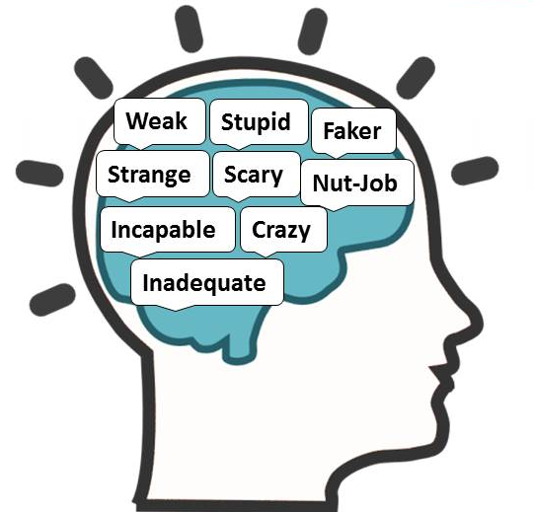
What is Self-Stigma?
Self-stigma: “Self-stigma is when a person with a mental illness accepts and agrees with negative cultural stereotypes. They feel ashamed, blameworthy, and try to conceal their illness from others.”
E.g., when someone avoids situations that may elicit stigmatizing responses.
Self-stigma is learned (and can be unlearned)

Slide 12
How Does Stigma Develop?
1. Awareness:
The public believes people with mental illness are weak.
4. Harm:
“Because I am weak, I am not worthy or able.”
2. Agreement:
“That’s right. People with mental illness are weak.”
3. Application:
“I have a mental illness so I must be weak.”

Slide 13
The Impact of Self-Stigma
Increased
Distress/Pain
Sense of Failure
Sense of Shame
Feelings of Inadequacy
Feeling “Not Normal”
Decreased
Self-Confidence
Self-Esteem
Hope
Sense of Comfort

Slide 14
Things your Mentee might feel or think…
“I don’t deserve to be at college/university”
“Everyone else can handle 5 classes.”
“I just can’t relate to other people, they don’t understand me, I don’t fit in”
“It’s so embarrassing to ask for help. People will think less of me.”
“I’ll never:
finish this paper
pass this exam,
graduate… it feels hopeless.”
“I don’t want to go on medication. That would mean I’m really ill.”
(Peterson, D., Barnes, A., & Duncan, C., 2008).

Slide 15
Reducing Self-Stigma
Peer Mentors can help to reduce self-stigma through their actions, words, and approach to their Mentee
Attentive, supportive presence
Modelling non-stigmatizing language and behavior
Reinforce and celebrate Mentee’s successes
Highlight differences between feeling and thinking
Help them regain a sense of control
Model and support hope

Slide 16
What a Peer Mentor Can Do: #1
Offer your Mentee your undivided attention and a respectful and supportive presence.
This is really powerful. This tells your Mentee:
“I don’t see you as inadequate”
“You are my peer”
“I respect you”
“I believe in you”

Slide 17
What a Peer Mentor Can Do: #2
Model non-stigmatizing language and behaviour
Use person-first terminology. (e.g. “the person with (depression, an eating disorder)”, rather than “the depressive”, “the anorexic”)
Show a sense of openness, comfort and ease when talking about mental health
Avoid hurtful or pejorative words or phrases to refer to people with mental health problems

Slide 18
What a Peer Mentor Can Do: #3
Encourage practical Success Identification in every meeting. Reinforce and celebrate your Mentee’s accomplishments and progress.
“Tell me three things you’ve done well this week.”
Remember: mental health problems often magnify failures and minimize successes. Mentors can help mentees to learn the new skill of raising the profile of their successes.

Slide 19
What a Peer Mentor Can Do: #4
Attend to and highlight differences between feeling and thinking. Validate the feeling, gently challenge the thinking.
Mentee: “I feel really upset with myself because the exam went so badly. I’m such a failure.”
Mentor: “It’s tough when an exam doesn’t go well. Let’s look at what worked and didn’t work for you.”
[Validate their disappointment, don’t validate the thought “I’m a failure”. Switch to problem-solving.]

Slide 20
What a Peer Mentor Can Do: #5
Help your Mentee regain a sense of control by:
Use the Wise Choice model to crease long-term and short-term goals.
Break things into smaller, manageable chunks
Encourage them to engage in practical and concrete strategies (e.g., mindfulness, relaxation activities, writing to do lists)
This will help to restore their confidence.

Slide 21
What a Peer Mentor Can Do: #6
Mental health problems can leave people feeling out of control and scared – these feelings can undermine hope.
Model and support hope:
“I know this is difficult to believe today, but it will get better”
“I know you can get through this”
“You’ve worked out problems like this before and you can do it again”

Slide 22
Remember
When we are combating self-stigma, we are modeling and teaching skills to:
Counteract a very powerful set of societal beliefs, and
Help mentees feel more comfortable with themselves.

Slide 23

One Thing I Learned

Slide 24
Resources
Self-Stigma Student Handout from the Victoria University of Wellington
http://www.victoria.ac.nz/st_services/disability/publications/
The Antidepressant Skills Workbook
http://www.comh.ca/antidepressant-skills/adult/workbook/
Heretohelp Wellness Modules
http://www.heretohelp.bc.ca/wellness-modules
HCDS Self-Help Workbook Series
http://www.queensu.ca/hcds/workbook.php
Anxiety BC Complete Home Toolkit
http://www.anxietybc.com/resources/selfhelp_home_toolkit.php

Slide 25
Bibliography
Centre for Addiction and Mental Health. (2012). Mental illness and addictions: Facts and statistics. Retrieved from http://www.camh.ca/en/hospital/about_camh/newsroom/for_reporters/Pages/addictionmentalhealthstatistics.aspx
Corrigan, P. W., & Rao, D. (2012). On the self-stigma of mental illness: Stages, disclosure, and strategies for change, Canadian Journal of Psychiatry, 57 (8), 464-469.
Disability Services, Victoria University of Wellington, New Zealand. (2011). Self-stigma. Retrieved from http://www.victoria.ac.nz/st_services/disability/publications/downloads/studentguides/Self%20Stigma%20e-version.pdf
Mental Health Commission of Canada. (2013). Opening minds: Interim Report. Retrieved from http://www.mentalhealthcommission.ca/English/system/files/private/document/opening_minds_interim_report.pdf
Peterson, D., Barnes, A., & Duncan, C. (2008). Fighting shadows: Self-stigma and mental illness. Retrieved from http://www.likeminds.org.nz/assets/Uploads/Fighting-Shadows.pdf
Woll, P. (2007). Healing the stigma of depression: A guide for helping professionals. Retrieved from http://www.mnmatec.umn.edu/Display%20Handouts%20Healing%20the%20Stigma%20of%20Depression.pdf

