Slide 1
Using LEAN & Stepped Care Process Methodology to Reduce Wait Times for Counselling Services
By Doug Stringer & Ben Bridgstock
October 14th 2019 CICMH

Slide 2
Agenda
Introductions
What you will and won’t get from this presentation
What is a Lean Approach?
The Story
  What was the Problem?
  The Change Process
  The Current State
Questions and Discussion
Notes:
Ben

Slide 3
Introductions
Doug Stringer;
Manager, Counselling Services & Spiritual Centre
Ben Bridgstock
  Director, Student Support Services
Notes:
Ben

Slide 4
What You Will Get From This Presentation
Longitudinal case-study of the implementation of Lean and Stepped Care
Time line of adjustments with
  Primary concern at each point
  Implemented solution
  Outcome
Data illustrating the impact of each change on key performance indicators
Notes:
Ben

Slide 5
What You Won’t Get From This Presentation
You Won’t Get…
Instructions for implementing Lean or Stepped Care
A set of global ingredients for reducing wait times
A guide for managing change with a team of clinical professionals
Notes:
Ben

Slide 6
What Are “Lean Values”?
Respect every individual – listen to all, empower all, encourage all, serve all
Lead with humility – leaders ask questions, listen and take a ‘one down’ view
Seek perfection – find root causes/solutions, chase flawless service delivery
Ensure quality at the source – seek to eliminate errors and mistakes
Scientific thinking – follow ‘plan-do-study-act’ process rigorously
Focus on process – results flow from processes, adjust one, impact the other
Think systemically – every aspect of the system must add value to the end user
Create constancy of purpose – remove all non value creating steps in process
Transparency through visual management – display data, act to address data
Notes:
Ben

Slide 7
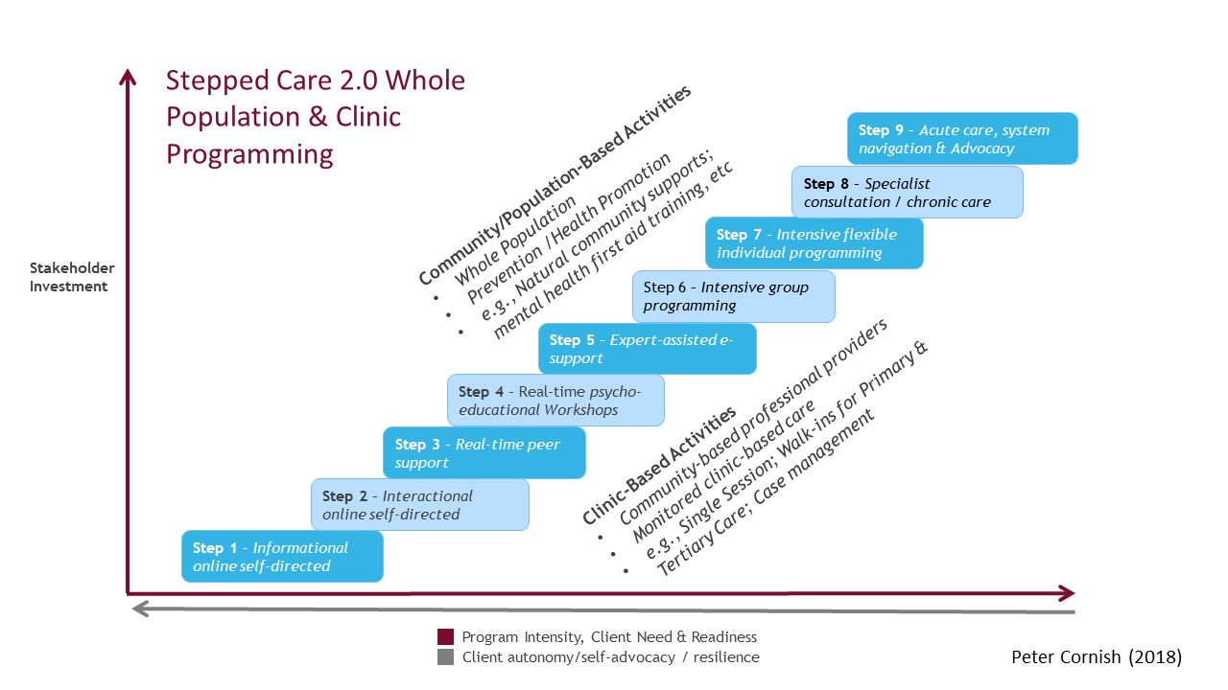
What is Stepped Care?
Notes:
Ben

Slide 8
The Journey from 2008 to Present

Slide 9
The Story: 2008/09
The Manager of Counselling Services noticed…
  Students asked to wait several weeks for appointments.
  Counsellors without students in their offices much of the time.
  Appointment scheduling system could not produce reports to capture KPI’s:
    # of appointments available
    # of appointments used
    Wait time for appointments
    # of students being served
Notes:
Jeff

Slide 10
The Story: 2008/09
The Manager asked for help from Chuck Doyle, Lean Specialist, he found:
Wait time of 3+ weeks
No-show rate of 30% - 40%
Counsellors completed an average of 2.4 sessions/day
Remaining time a mix of no-shows and workshops.
No triage for students in acute distress
Multiple follow-up sessions booked for clients – up to 10 weeks
Notes:
Jeff

Slide 11
The Story: 2008/09
Initiated Lean process review Spring, 2009:
Value Stream Analysis completed to track path of students
Kaizen event with part of Counselling team to address KPI issues
Chuck recommended moving to a Walk-In only access model.
Notes:
Jeff

Slide 12
The Story: 2009/10
However…
Limited consensus between Manager and Counselling Team
Manager mandated changes to appointment scheduling process:
  3 Same-Day Appointments
  3 Pre-Booked Follow-Up Appointments
  Limit of 2 week pre-booking
No data compiled for this period.
Notes:
Jeff. No data for this period.

Slide 13
The Story: 2010/11
Intake process implemented
  1 hour intake sessions
  Focused on triage and balancing case-load
  Used 2 counsellor positions
Assigned delivery of workshops to single PT Counsellor
Capped session limit at 6 per student
  Exceptions permitted following case review with Manager
Created method for tracking Service Volume KPI’s
  Including Demand for Appointments
Notes:
Jeff

Slide 14
The Story: 2010/11
Notes:
Jeff
Switch to line graph

Slide 15
The Story: 2011/12
Jeff Agate becomes Manager, Counselling Services
Discontinued Intake process
Adjusted ratio of Same-Day : Follow-Up appointments to meet changing demand across academic year
Created new type of Same-Day appointment – Urgent
  Coverage of Urgent appointments across Counselling schedule
  Each counsellor assigned 4 Urgent appointments per week
Capped daily session limit at 5
Identified peak periods of demand for appointments
  Scheduled meetings during non-peak periods
  Staggered counsellor lunches to ensure coverage through mid-day
Notes:
Jeff. Jeff becomes manager.

Slide 16
The Story: 2011/12
Notes:
Jeff

Slide 17
The Story: 2012/13
Moved to new Student Commons services space
  Increased promotion of Counselling
  Extended service hours from 8:45-4:45 to 8:00-6:00
  One-Stop shared reception desk
    Drafted clear guidelines for appointment booking
Re-Launched Intake process.
  3 PT non-counsellor mental health workers added
  30 minute sessions
  110 Intake sessions available each week
  Completed counselling-admin tasks and basic referrals
Notes:
Jeff

Slide 18
The Story: 2012/13
Notes:
Jeff

Slide 19
The Story: 2013/14
Implemented Urgent Counsellor role
  Experienced crisis counsellor
  Single-session model
Increasing awareness and de-stigmatization of mental health
  Continued increase in demand for Counselling
Provided feedback to individual counsellors based on KPI Data
  # Unique students seen (Case Load)
  # Appointments completed
  Mean # Appointments per student
  % Appointment no-show rate
Notes:
Jeff

Slide 20
The Story: 2013/14
Notes:
Jeff

Slide 21
The Story: 2014/15
Solidifying of changes made to date
Increasingly detailed measurement of Counselling KPI’s
Enhanced relationship with Residence Life team
  Training of Residence staff team
  Increased promotion of Counselling Services
  Priority referral procedure
Notes:
Jeff

Slide 22
The Story: 2014/15
Notes:
Jeff

Slide 23
The Story: 2015-16
Ben Bridgstock becomes Manager, Counselling Services
Umbrella Project
  Substance Use Harm-Reduction Project
  Increased awareness of substance use issues across college
  Training delivered to counselling team
  Addiction Counsellor available for consultations
Student satisfaction survey initiative
  Identifying most valued aspects of Counselling Services
  Included feedback on difficulty acquiring appointments
Notes:
Ben

Slide 24
The Story: 2015/16

Slide 25
The Story: 2016-17
  Student feedback centered on access, wait time experienced before meeting a counsellor and availability of counsellors to meet with them on a regular basis
  Guest speakers/trainers invited to share ideas about service delivery to the Counselling team, including;
    Coordinator of the walk in clinic at Family Services Ottawa,
    Dr. Peter Cornish, Memorial University
    Dr. Jennifer Thake professor & lead clinician at Terrace Wellness
    Dr. Simon Hatcher, a Psychiatrist at the Ottawa Hospital
Notes:
Ben

Slide 26
The Story: 2016-17

Slide 27
The Story: 2017-18
  Preparations for Stepped Care model of service delivery:
    Hired a counsellor to run groups
    Counsellors trained in single-session in preparation for walk-in
    Counsellors involved in planning and preparation of service model change
    Instituted BHM 20 for feedback-informed service for all students who come with a mental health concern
    Initiate use of Therapy Assisted Online (TAO)
Notes:
Ben

Slide 28
The Story: 2017-18

Slide 29
The Story: 2018-19
  Doug Stringer becomes Manager, Counselling Services
  Intake process removed in favour of daily walk-in access to Counselling Services as the entry point
  Once a student has accessed a counsellor, subsequent appointments can be scheduled
Notes:
Ben

Slide 30
The Statistics: 2018-19
  Over the 18/19 academic year 77% of students who came were seen “that day”, either through Walk-in or Urgent appointments
  In 2017-2018 there were 1672 Intake appointments and 3205 Counsellor appointments
  In 2018-2019 there were 0 Intake appointments and 3992 Counsellor appointments
Notes:
Ben

Slide 31
The Statistics: 2018-19
  Even with the removal of all Intake appointments, total unique students served increased from 2799 to 2942
  1041 students attended groups and events run by our groups counsellor
Notes:
Ben

Slide 32
The Statistics: 2018-19
  In April 2018, 90% of Students stated that they would recommend Counselling Services to a friend (down 6 % from the previous year.)
  In April 2019, 98% of students surveyed indicated they would recommend Counselling Services to a friend
  In April 2018, 83% of students said they came away from counseling with a good plan to address their issues (down 8 % from the previous year)
  In April 2019, 95% of students said they came away from counseling with a good plan to address their issues
  In April 2018, 54% of students felt they were able to meet with their counsellor as often as they would like (down 18 % from the previous year)
  In April 2019, 95% of students stated they believe Counselling Services is available when they need support
  In April of 2018, 35% of student comments expressed concerns about access, scheduling and wait times between appointments
  In April of 2019, 21% of student comments expressed these same concerns
Notes:
Ben

Slide 33
The Story: 2018-19

Slide 34
Thank You!
Any Questions?

