Slide 1
Coaching Health and wellness
Encouraging Healthy Behaviours
Lauren Armstrong
Peer Health Outreach Coordinator
Queen’s University
Queen’s University Health Promotion

Slide 2
Overview
What is health?
How the components of health overlap
Social Determinants of Health
Models of Health Behaviour Change
Starting the Conversation with a Mentee
Coaching Healthy Habits in a Mentee
Resources
Case Studies
Queen’s University Health Promotion

Slide 3
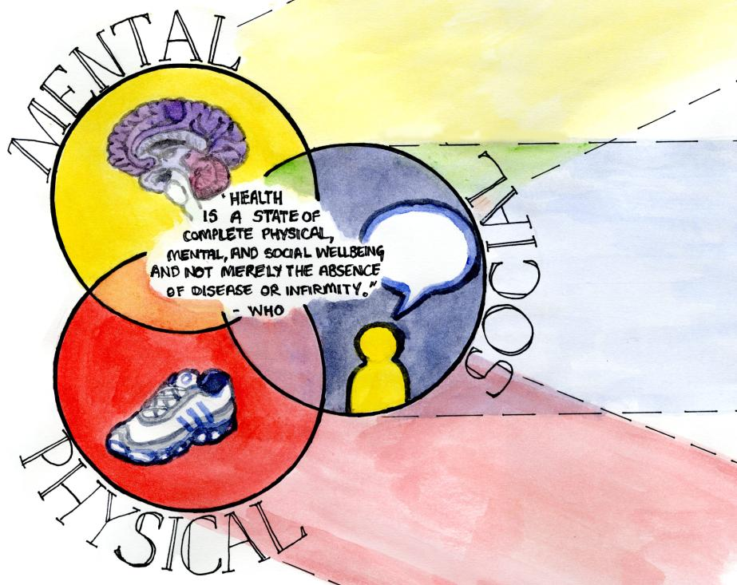
What is Health?
Image credit: Faith Webster, Queen’s Health Promotion

Slide 4
Student Health Survey 2013
Good news:
76.7% of Canadian students rated their overall health as good or very good
66.1% of Canadian students feel happy almost every day or every day
Not so great news:
81.6% of Canadian students did not meet physical activity standards
86.7% of Canadian students did not meet standards for healthy eating
Source: American College Health Association. American College Health Association-National College Health Assessment II: Canadian Reference Group Data Report Spring 2013. Hanover, MD: American College Health Association; 2013.

Slide 5
Shouldn’t it be obvious?
Why don’t people change behaviours that are obviously not good for them? A student might:
Lack self-efficacy
Lack self-esteem
Feel it is too difficult
Have little or no health education
Lack motivation
Experience medical issues
Face factors or obstacles beyond their control
Queen’s University Health Promotion

Slide 6
Social Determinants of Health (SDH)
Income and Income Distribution
Education
Unemployment and Job Security
Employment and Working Conditions
Early Childhood Development
Food Insecurity
Housing
Social Exclusion
Social Safety Network
Health Services
Aboriginal Status
Gender
Race
Disability
Queen’s University Health Promotion

Slide 7
Example of SDH
Why is Jason in the hospital?
Because he has a bad infection in his leg.
But why does he have an infection?
Because he has a cut on his leg and it got infected.
But why does he have a cut on his leg?
Because he was playing in the junk yard next to his apartment building and there was some sharp, jagged steel there that he fell on.
But why was he playing in a junk yard?
Because his neighbourhood is kind of rundown. A lot of kids play there and there is no one to supervise them.
But why does he live in that neighbourhood?
Because his parents can't afford a nicer place to live.
But why can't his parents afford a nicer place to live?
Because his Dad is unemployed and his Mom is sick.
But why is his Dad unemployed?
Because he doesn't have much education and he can't find a job.
But why ...?
Federal, Provincial and Territorial Advisory Committee on Population Health. (1999). Toward a healthy future: Second report on the health of Canadians Ottawa, ON: Minister of Public Works and Government Services Canada. Retrieved from http://www.phac-aspc.gc.ca/ph-sp/report-rapport/toward/pdf/toward_a_healthy_english.PDF

Slide 8
Other factors
Religion/spirituality
Environment
Emotional health
Physical/built environment

Slide 9
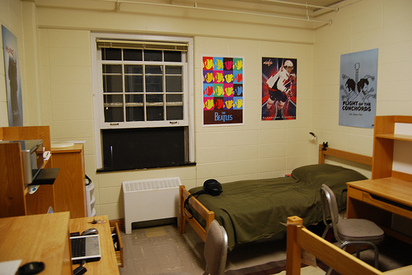
Sleep
Keep your curtains closed at night to help keep your room dark.
Write down things that are on your mind before bed.
Avoid intense exercise 3 hours before bed.
Establish a pre-sleep routine to signal your body that it’s time to sleep.
Keep your bedroom cool at night
Keep your
alarm clock
out of sight.
Reserve your bed for sleep
Turn off all lights, screens and music

Slide 10
What Motivates Someone to Change?
Popular health models include:
Health Belief Model
Stages of Change
Learning Theories
Social Cognitive Theory
Queen’s University Health Promotion

Slide 11
Health Model Review
What are the key concepts?
If there are steps or stages, what are they?
How can this model help you when mentoring a student who needs to or would like to change a health behaviour?
Is there anything missing from the theory?
Afterwards we’ll reflect on:
What do all of the models have in common?
Queen’s University Health Promotion

Slide 12
Health Model Commonalities
Change is intrinsically motivated
It can be a process involving many steps
Understanding how the behaviour is affecting their life
How easy a change is to implement
Social norms
How easy overcoming barriers are
Importance of social support
Viewed as being able to maintain over long term
Queen’s University Health Promotion

Slide 13
Tips for Coaching Health Behaviour Change
Be patient — change may take a while
Expect some ups and downs
Just because your advice was ignored, it doesn’t mean the message didn’t have an impact
Balance of personal experience vs. individuality
Follow up and offer encouragement and support
You don’t have to have all the answers!
Total elimination is not always possible or realistic
Queen’s University Health Promotion

Slide 14
The Guilt Complex
“There are better things I could be doing with my time”
“I’m too busy to do this”
Change the focus to:
“I am actively choosing to take care of myself”
“What I am doing right now is a positive, healthy choice”
Queen’s University Health Promotion

Slide 15

The Baby Carrot Story
There is always an equal or similar solution
May need to play around to find out what works
Just because it sounds weird, doesn’t necessarily mean it’s wrong or unhealthy
Queen’s University Health Promotion

Slide 16
Facilitating the Conversation:
Mentee is Interested in Changing
How would you like things to be different?
What kinds of healthy changes do you think you could make this week?
On a scale from 1-10, how ready are you to make changes in your _____ patterns?
How can I help you with ___?
When would you be most likely to___?
What have you tried before to make a change?
What do you want to do next?
Queen’s University Health Promotion

Slide 17
Facilitating the Conversation:
Mentee is Unsure of Change
What do you think will happen if your health behaviors don't change?
How would your life be different if you adopted a healthier lifestyle?
Is this something you are hoping to change?
Would you be interested in getting more information on that?
I used to think that too, but then _______
I actually heard of this really interesting ______
Motivational assessment: Appeal to what motivates the person
Queen’s University Health Promotion

Slide 18
Helping a Mentee who is “Stuck”
It’s okay, it happens to everyone
Focus on small manageable steps
Identify if it’s appropriate to push through or try a new strategy
Re-identify what prompted the change in the first place
Queen’s University Health Promotion

Slide 19
Case Study Activity
In your small group, review the case study and discuss the following questions:
What is the main concern in this situation?
Are you concerned about anything else?
What would you say to this person to begin the conversation?
If they are nervous or unsure, what suggestions can you make?
What follow-up would you offer, if any?
Queen’s University Health Promotion

Slide 20
Remember that You’re Not Alone
Student Health 101
Health Promotion Department
Student Health/Wellness Centre
Healthy Lifestyle Consultations
Student-run Health Programs (run club, yoga club, etc.)
Leave the Pack Behind (Ontario-wide organization)
Queen’s University Health Promotion

Slide 21



Thank You!
Follow us at:
    “Queen’s University Be Well”
    @QueensUBeWell
    queensubewell.blogspot.ca/
lauren.armstrong@queensu.ca
Queen’s University Health Promotion

