Slide 1
Your Voice Matters:
A Dialogue about Student Mental Health
Standard for Psychological Health and Safety of Post-Secondary Students

Slide 2
Land acknowledgment
WRITE LAND ACKNOWLEDGEMENT HERE
Notes:
TIPS:
It’s always best to make this personal. Our suggestion, after acknowledging the territory and the people, is to share what that means to you – your relationship to Indigenous Peoples, the post-secondary institutions, etc. Think about how acknowledging these relationships and this land will impact the work you’re doing.
The following link goes to a page with land acknowledgements written by university-based Indigenous councils or advisory groups. You can use the appropriate acknowledgement as a starting point for what you want to say on this slide and use it to open your meeting: https://www.caut.ca/content/guide-acknowledging-first-peoples-traditional-territory.
If your school is not included in the list, we recommend reaching out to the Indigenous Student Centre at your campus, or a local Indigenous organization, to ask what the appropriate land acknowledgment would be.

Slide 3
Today’s dialogue: Agenda
Welcome
Warm-up activity
Why a Standard
Group discussion / roundtable check-ins
Wrap-up and final remarks
Notes:
TIPS:
If your meeting is very long, you may want to adjust the agenda to include lunch and health breaks.
Depending on how your meeting is set up, you may also wish to adjust the group discussion step and explain more about that process (will you discuss the questions in sequence, will you break into smaller groups to discuss one or all questions, etc.).
SPEAKING POINTS:
I’d like to start by welcoming you all to this dialogue. My name is [Name], and I’m [Explain who you are, if you represent an organization, etc. Explain briefly why you wanted to host this dialogue.] Before we get into the main discussion, I’d just like to let you know that the bathrooms are [Provide directions].
Here’s how our session will flow today. I’ll present some background information to give you some context about why we’re having this dialogue in the first place.
Then we’ll do a quick warm-up activity to get everyone comfortable with each other and ready to discuss our topics for today.
After that, we’ll present our main questions for the day and we’ll get into discussing them. We’ll spend about [x time] on that stage to give us a chance to cover as much as possible.
Then we’ll have a brief roundtable on what we learned today, and we’ll check in with everyone to make sure we’re leaving in a good headspace.
We’ll finish up by going over what happens next, and then we’ll be done.

Slide 4
IMPORTANT
If you find yourself in distress,
please call Crisis Services Canada at
1-833-456-4566
or
Text HOME to 686868 in Canada to text with a trained Crisis Responder
Notes:
TIPS:
You may choose to provide the contact information for your local distress centre instead of or in addition to the national line. You can find your nearest distress centre at this URL: https://suicideprevention.ca/need-help/
You can also include contact information for any campus mental health resources that are available.
If you have one or more support people present, introduce them to the group, and let participants know they can reach out to these people if they need anything.

Slide 5
Safer Space Guidelines
Respect others’ physical and emotional boundaries.
Respect others’ identities and backgrounds, including pronouns and names.
Do not assume or make judgments on anyone’s gender identity, sexual preference, survivor status, health status, economic status, religion, background, beliefs, opinions, etc.
Respect others’ right to privacy both during this dialogue and beyond.
Be aware that your actions and words have effects on other people.
Notes:
Note that you can find a set of Safer Space guidelines in the Tools and additional resources section of the Dialogue in a Box guide.
SPEAKING POINTS:
Before we get going, I’d like to set some guidelines for making sure we have a productive, respectful and safe discussion today. [Present safer space guidelines and ask if anyone has any additional guidelines they’d like to include.]
I’d also like to remind you all that we may get into some heavy subject matter today, and it’s really important that you all take care of yourselves and of each other. As I mentioned, if at any point things get to be too much and you need to excuse yourself, please do so. And I urge you to get in touch with a distress centre if you need to, either during this session or later.
And now, to get ourselves warmed up and ready to share our experiences, I’d like to invite you all to [introduce & conduct your warm-up activity – see the guide for example activities].

Slide 6
Safer Space Guidelines
Avoid raising your voice, interrupting or talking over anyone else, and make sure everyone gets a chance to speak.
Assume positive intent.
Remember we are all learning.
Take care of your own safety.
If you witness any abusive or other inappropriate behaviour, let the facilitator know.
Notes:
Note that you can find a set of Safer Space guidelines in the Tools and additional resources section of the Dialogue in a Box guide.
SPEAKING POINTS:
Before we get going, I’d like to set some guidelines for making sure we have a productive, respectful and safe discussion today. [Present safer space guidelines and ask if anyone has any additional guidelines they’d like to include.]
I’d also like to remind you all that we may get into some heavy subject matter today, and it’s really important that you all take care of yourselves and of each other. As I mentioned, if at any point things get to be too much and you need to excuse yourself, please do so. And I urge you to get in touch with a distress centre if you need to, either during this session or later.
And now, to get ourselves warmed up and ready to share our experiences, I’d like to invite you all to [introduce & conduct your warm-up activity – see the guide for example activities].

Slide 7
Why a Standard?

Slide 8
A critical time for youth
Many mental health illnesses are first diagnosed between the ages of 16 and 24
Those diagnoses are happening during what is already a major transitional period
This makes it critically important for post-secondary institutions to support student mental health
Notes:
SPEAKING POINTS:
There are two million students right now in higher education — at universities, colleges, CEGEPs, polytechnics, etc.
Most students are between 16 and 24, which is also the age range with the highest rates of mental health diagnoses.
Specific factors that contribute to Post Secondary Student mental health stress include:
Moving to a new place/country
Citizenship/immigration status
Stigma
Feelings of belonging
Experiences of oppression
Discrimination
Colonialism
Accessibility issues
Life stage or transition
There are so many different types of students and life stages to consider including:
Distant / Online students
live on campus or off campus
are a resident or commuter
live at home or live independently
work during academic year or do not work
work on campus or off campus
For all these reasons, post-secondary institutions are facing increased demands and pressures to support the mental health and wellbeing of their students in order to support student academic success.

Slide 9
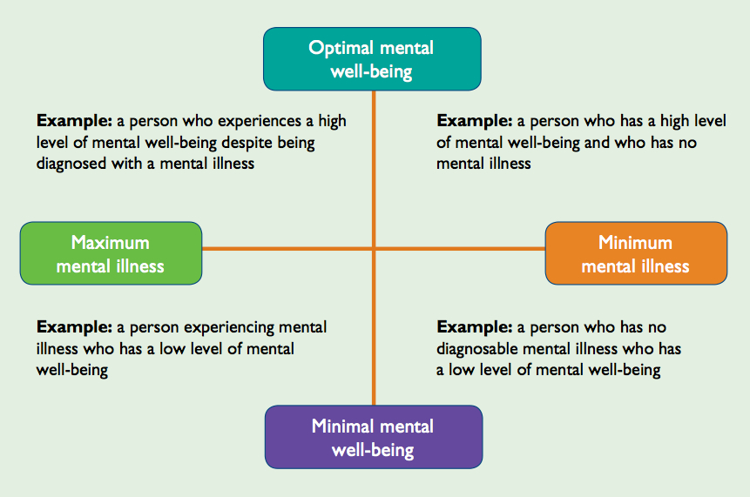
Mental health is a continuum
(Keyes, 2002)
Notes:
SPEAKING POINTS:
Mental health is not binary — that is, a person is not either mentally healthy or mentally unhealthy. It exists on a continuum, and may or may not be related to a mental illness.
It’s also not static. A person’s mental health can fluctuate along the continuum at various points of their life.
Thinking of it this way helps to avoid stigmatizing labels and non-professional diagnoses.
Source: Keyes, C. L. M. (2002). The mental health continuum: From languishing to flourishing in life. Journal of Health and Behavior Research

Slide 10
Stress has consequences
Stress
Distress
Impacts on academics
Notes:
SPEAKING POINTS:
Stress:
Results from the 2016 National College Health Assessment survey, conducted among 43,000 post-secondary students at 43 institutions across Canada, indicate a high prevalence of stress among students.
Sources of stress identified in the literature include:
Academics (time management, assignments, exams, etc.)
Campus culture (includes environmental issues such as racism, sexism, sexual harassment and perceived safety, in addition to socio-cultural issues like pressure to fit in, pressure to engage in substance use during socialization, etc.)
Adjustment to post-secondary life
Financial stress
Relationships/Interpersonal stress
Concern for the future (i.e., securing a job)
Distress:
Anxiety (18.4%) and depression (14.7%) were the most prevalent diagnosed mental illnesses during the past 12-month period, with just over one-fifth of students (20.4%) reporting having received a professional diagnosis of depression at some point in their lifetime.
Impact on academics:
Stress and distress has repeatedly been linked to negative academic outcomes, including reduced academic achievement, challenges with alertness and reduced ability to focus, and student attrition and retention. 65% of students surveyed said stress had some negative impact on their studies.

Slide 11
Three areas of focus
Equity Seeking Groups
Coping & Help seeking
Programs & Interventions
Notes:
SPEAKING POINTS:
The MHCC contracted Dr. Heather Stuart and her team at Queen’s University to do a scoping review of current literature. The goal was to share information about — and promote uptake of — emerging and promising practices. That review identified three main areas of focus in the literature:
Equity Seeking Groups:
Several subgroups were found to be at increased risk for stress and distress, including students belonging to ethnic minorities, international students, military (or previously military) members, members of the 2SLGBTQ+ community and Indigenous students. For the reasons that we spoke about in the previous slide about the critical time for youth in PSI.
Coping and help seeking:
Successful coping, such as reaching out for help either informally or formally can help to mediate stress and prevent it from developing into distress (i.e., mental illness).
Despite a large proportion of students reporting high levels of stress and distress, few students reported seeking help. Help seeking was particularly low among male students and students belonging to ethnic minorities.
Students frequently reported the misuse of alcohol and other substances as a method of dealing with stress and distress (i.e., a negative coping mechanism).
Programs/interventions:
Many post-secondary institutions have implemented programs or interventions to improve the psychological health and resilience of their students, but few of these programs have been formally evaluated (meaning few can provide evidence for their effectiveness).
Individual programs/interventions range from more innovative options, such as animal therapy and mindfulness workshops, to more classic interventions, such as cognitive behavioural therapy or skills counselling.

Slide 12
A multitude of needs
Standard
Anti-stigma and awareness
Campus environment
Training
Monitoring
Substance use and harm reduction
Partnerships
Whole-campus approach
Student centeredness
Prevention to treatment
Knowledge exchange and evaluation plan
Notes:
SPEAKING POINTS:
The scoping review also identified 11 key themes and needs:
Need to create a mentally healthy campus environment
Need cohesion at the pan-Canadian level and a national Standard to guide provincial and institutional mental health efforts
Need to create partnerships between governments, institutions, student groups and community mental health agencies
Need an expanded definition of “mental health” to include substance use and harm reduction
Need to adopt a whole-campus approach to mental health
Need to maintain student centeredness in all activities
Need a concentrated and coordinated mental health plan for post secondary students that covers a range of services from prevention to treatment
Need a knowledge exchange and evaluation plan for institutional tools
Need anti-stigma and mental health awareness and literacy programs to promote early identification and improve help-seeking
Need training for all faculty and staff to support early identification and appropriate referrals
Need to implement ongoing monitoring, quality assurance assessment and systematic evaluation activities

Slide 13
One key need: A Standard
Standard
Anti-stigma and awareness
Campus environment
Training
Monitoring
Substance use and harm reduction
Partnerships
Whole-campus approach
Student centeredness
Prevention to treatment
Knowledge exchange and evaluation plan
Notes:
SPEAKING POINTS:
The MHCC is championing the development of a voluntary standard for psychological health and safety for post-secondary students. They are working with CSA Group, Canada’s leader in standards research, development, education and advocacy. CSA Group has put together a Technical Committee of subject matter experts from coast to coast to coast, they are working to write the content of the Standard.

Slide 14




Who is involved?
Project leads
Funding partners
Other partners
Notes:
SPEAKING POINTS:
The MHCC is championing the development of a voluntary standard for psychological health and safety for post-secondary students, with the support of funders such as Bell Let’s Talk, The Rossy Foundation and Royal Bank of Canada. MHCC is partnering with organizations such as Colleges and Institutes Canada, Universities Canada and Canadian Alliance of Students Associations.

Slide 15







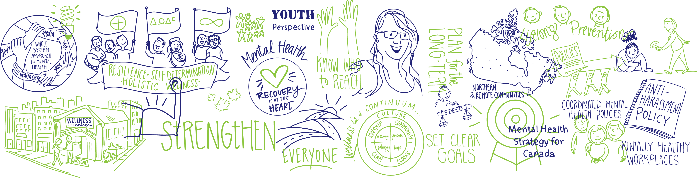




Executive Advisory Committee members
MHCC Youth Council

Slide 16
Who is on the Standard development Technical Committee?
User interest
Representing the interests of students (and their families as support)
Organization interest
Representing post-secondary institutions (functional)
Government interest
Service providers
General interest
Provincial, Federal and Territorial agencies supporting mental health and/or post-secondary institutions
Representing the interests of those providing services to Post-secondary institutions (organizational) and to students (response/ treatment)
Academics/researchers in the Post-Secondary health field
Notes:
SPEAKING POINTS:
The CSA Group has created a Technical Committee of experts from coast to coast to coast, representing the five interest groups.
User interest
Organization interest
Government interest
Service providers
General interest
Recruitment of Technical Committee
CSA Group starts with a list of recommended candidates – over 400 from across Canada
The initial list is reviewed for
Distribution
Refined category profiles
Gaps
Key advocates
SELECTION of TC
The final selection of committee members is based on
Expertise & active participation
Balanced representation
Regional
Demographic
Issue orientation

Slide 17

What’s the goal?
Student success!
Notes:
SPEAKING POINTS:
The goal of the Standard is to support student success through the development and implementation of a practical and flexible framework that enables institutions to strengthen and promote students’ psychological health and safety.
Such a framework will provide post-secondary institutions and other key partners with guidance to help them develop policies that will:
Increase mental health awareness and decrease stigma around mental illness and other mental health problems
Increase access to supports for students both on and off campus
Promote healthy and safe life skills that students can apply at school, at work and in daily life
Provide healthier and safer post-secondary institutional environments
With these conditions in place, all students will be better positioned to succeed.

Slide 18
Scope of the Standard
The current scope of the Standard includes identifying, assessing and reducing risks to the mental health of post-secondary students.
It also includes offering guidance to post-secondary institutions on ways they can help to improve and protect student mental health throughout their post-secondary education.
Notes:
The final scope of the Standard will be determined by the CSA Group Technical Committee.

Slide 19
How a Standard will help
Benefits for students
Improved student coping skills, mechanisms and resiliency
Greater willingness to seek help
Increased mental health awareness and decreased stigma
Notes:
SPEAKING POINTS:
Use of positive coping mechanisms
Willingness to disclose MH issues
Awareness of MH supports and services
Increase positive attitudes toward help seeking
Decreased stigma towards self and others

Slide 20
How a Standard will help
Benefits for institutions
Increased access to and use of
services
Increased mental health literacy
Responsive faculty and staff
Notes:
SPEAKING POINTS:
Responsive faculty and staff
Mental Health Literacy
Accessibility of services
Knowledge exchange activities

Slide 21
Our dialogue
Notes:
SPEAKING POINTS:
Before we get into the main part of today’s discussion, does anyone have any questions?
How are we all feeling?
Need a little break?
Bathroom, fresh air, etc.?

Slide 22
Group discussion
Question to consider
In your experience, what works well to promote student mental health?
Notes:
SPEAKING POINTS:
Here we’re asking you to consider anything you’ve observed or experienced that helps support mental health. Some examples include feelings of belonging, reasonable courseloads or access to physical fitness facilities.
For this question, we’ll... [explain how you’d like to conduct the discussion for this question. See below for examples, based on group size, but feel free to use other exercises as you see fit.]
TIPS:
Suggested small group exercise
Ask participants to share an example of something they’ve observed that supported mental health.
Suggested large group exercise
Ask participants to share examples of factors they’ve seen or experienced that have supported mental health. Have your note-taker write suggestions on a flipchart.

Slide 23
Group discussion
Question to consider
Which promising or best practices are you aware of that are helping to promote and support student mental health?
Notes:
SPEAKING POINTS:
Here we’re asking you to consider practices or programs you’ve heard of that have been effective at supporting mental health, or that you think could work in your own community.
For this question, we’ll... [explain how you’d like to conduct the discussion for this question. See below for examples, based on group size, but feel free to use other exercises as you see fit.]
TIPS:
Suggested small group exercise
As a group, try to come up with three examples of best practices you’ve seen or heard of that are helpful.
Suggested large group exercise
Ask participants to provide examples of programs or practices they’ve seen or heard of that are helpful. Have your note-taker write suggestions on a flipchart.

Slide 24
Group discussion
Question to consider
What barriers do students face in seeking to attain optimum mental health?
Notes:
SPEAKING POINTS:
Here we’d like you to think about anything that stands in the way of optimal mental health. Some examples might include ineffective programs, policies that make it difficult to access services, societal stigma, classroom structures, institutional barriers, etc.
For this question, we’ll... [explain how you’d like to conduct the discussion for this question. See below for examples, based on group size, but feel free to use other exercises as you see fit.]
TIPS:
Suggested small group exercise
Ask participants to think of a systemic barrier that made it difficult for them or someone they know to get mental health support.
Suggested large group exercise
Break into smaller groups (no larger than 10) to discuss this question. Have each group come up with one or two barriers they think are most detrimental. To finish, bring the whole group back together and have each group share the barriers they came up with. Have your note-taker record these on a flipchart.

Slide 25
Group discussion
Question to consider
What would you like post-secondary institutions to address to better support students and their mental health needs?
Notes:
SPEAKING POINTS:
Here we’re aiming to prioritize the absolute most important elements for making sure the Standard can really be effective.
For this question, we’ll... [explain how you’d like to conduct the discussion for this question. See below for examples, based on group size, but feel free to use other exercises as you see fit.]
TIPS:
Suggested small group exercise
Ask each person for their number one priority for inclusion in the Standard.
Suggested large group exercise
Post the flipcharts from the previous exercises, along with a blank one and some markers. Give each participants 3–5 coloured stickers and invite them to either place stickers next to the topics they think are the highest priorities or add a new one to the blank sheet.

Slide 26
Wrap-up and next steps
[Include a note or two on your next steps, if you wish]
Notes:
SPEAKING POINTS:
[Recap what you heard today.]
I want to thank you all very much for being here today and for sharing your perspectives about this important topic. I’ll be taking your input and submitting it to the CSA Group technical committee in the next few days. They’ll use it to develop the Standard, which will be available for public review starting in August. You can visit the CSA Group website for more details about how to participate in the review process — I’ll be sending you that link in an email.
Before we go, I’d just like to remind you all one more time about the importance of self-care. We’ve talked about some difficult things today, so I want you all to do what you need to to protect your mental health. If you need to reach out, please do not hesitate to do so.

Slide 27






Stay involved
On social media
#StudentSuccess
By email
studentstandard@mentalhealthcommission.ca
Mental Health Commission of Canada
350 Albert Street, Suite 1210, Ottawa, ON Canada K1R 1A4
O: 613-683-3922 / C: 613-552-0982 / F: 613-798-2989
www.mentalhealthcommission.ca
Notes:
SPEAKING POINTS:
If you’d like to stay involved with the MHCC or keep informed about the Standard development process, you can follow the MHCC and use #studentsuccess.

